Slide 1

National University of Computer and Emerging Sciences
Generative Adversarial Networks
AI-5004 Adv. Topics in Generative AI
Dr. Muhammad Nouman Noor
Department of AI & DS

Slide 2
Goals
Review of Previous Lecture
Today’s Lecture
Similarity Measures
Problems with GAN Training
DCGANs

Slide 3
Review of Previous Lecture

Slide 4
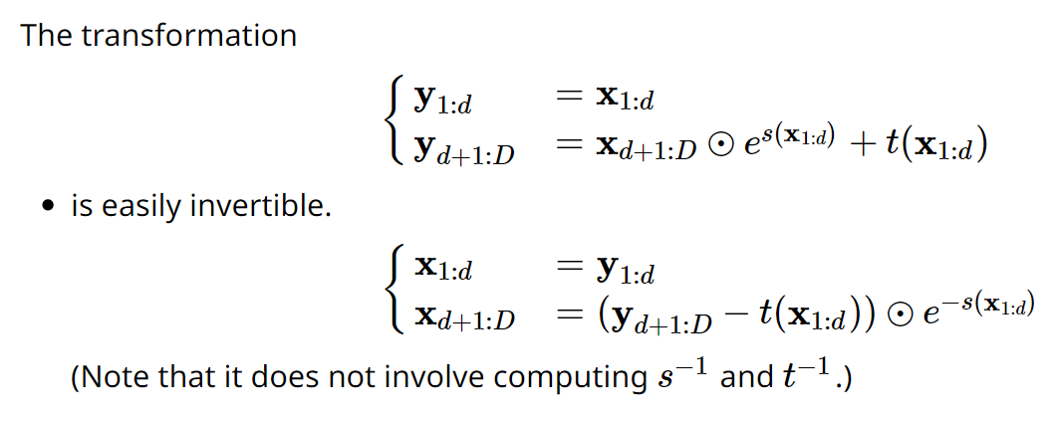
RealNVP - Affine coupling layers

Slide 5
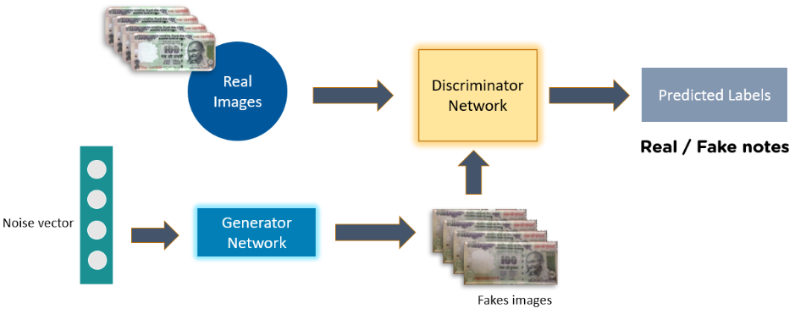
Generative Adversarial Network
Complete GAN Network

Slide 6
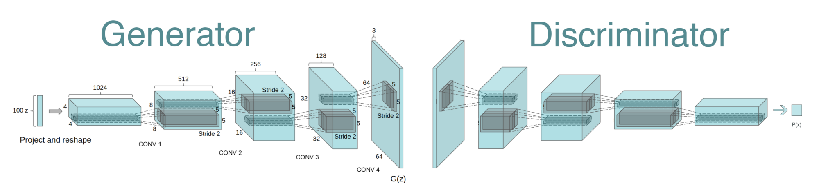
Generative Adversarial Network (GAN)
Reshape,
FC, sigmoid
FC, BN, ReLU
Reshape
Conv (kernel 5x5, stride 2)
BN, LReLU (slope 0.2)
Deconv, tanh/sigmoid
Deconv (kernel 5x5, stride 2)
BN, ReLU
https://github.com/PramodShenoy/GANerations

Slide 7
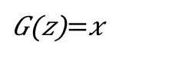
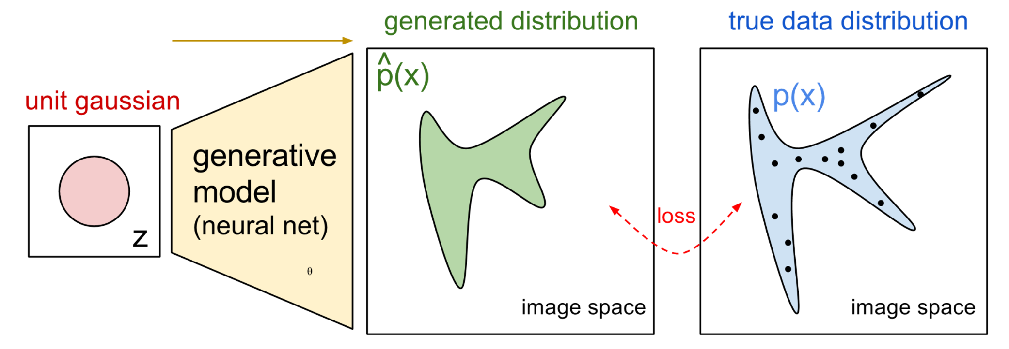
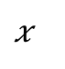
NN for P_{G}(x; θ)
P_{G}(x,θ)
P_{data}(x)
G
θ
Prior
distribution
of z
Smaller
dimension
Larger
dimension
How to compute the likelihood?
https://blog.openai.com/generative-models/

Slide 8
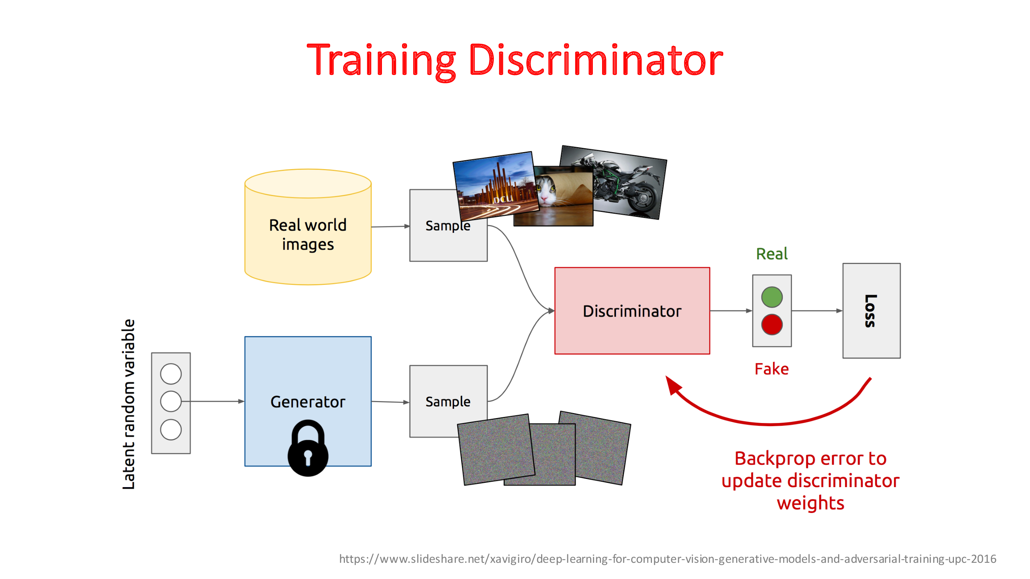

Slide 9
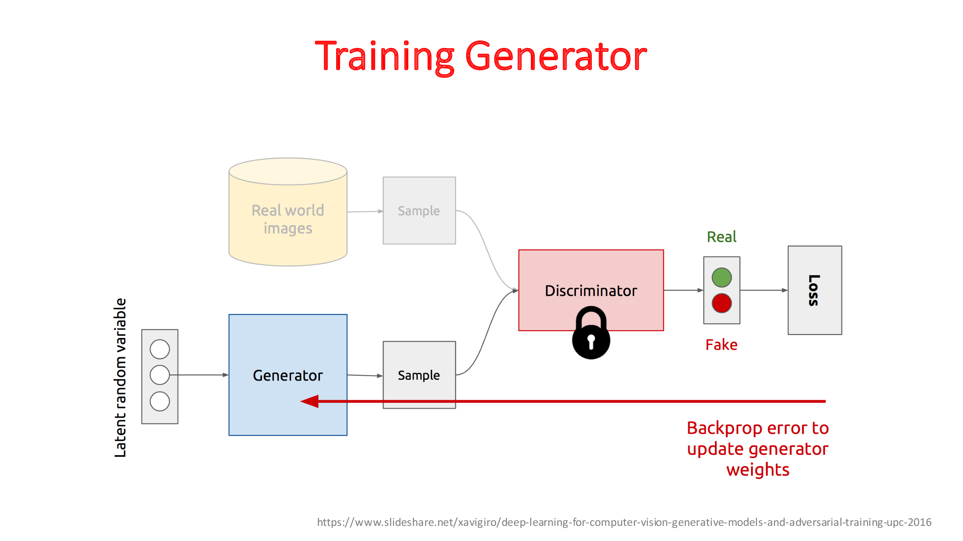

Slide 10
Loss Functions
Minimax Loss

Slide 11
Today’s Lecture

Slide 12
Issues: Convergence
As the generator improves with training, the discriminator performance gets worse
Discriminator can’t differentiate between real and fake.
If the generator succeeds perfectly, then the discriminator has a 50% accuracy.
Starts random guess (Less meaningful)
Warning: The generator may start to train on random feedback, and its own quality may reduce.

Slide 13
Problems
Imbalance
One network may dominate the other
e.g. discriminator may always tells the fake and real data and generator may not be able to fool the generator
Local Convergence
We may stuck at a local minima and not the global error
The discriminator feedback gets less meaningful over time.
The generator starts to train on junk feedback, and its own quality may collapse.

Slide 14
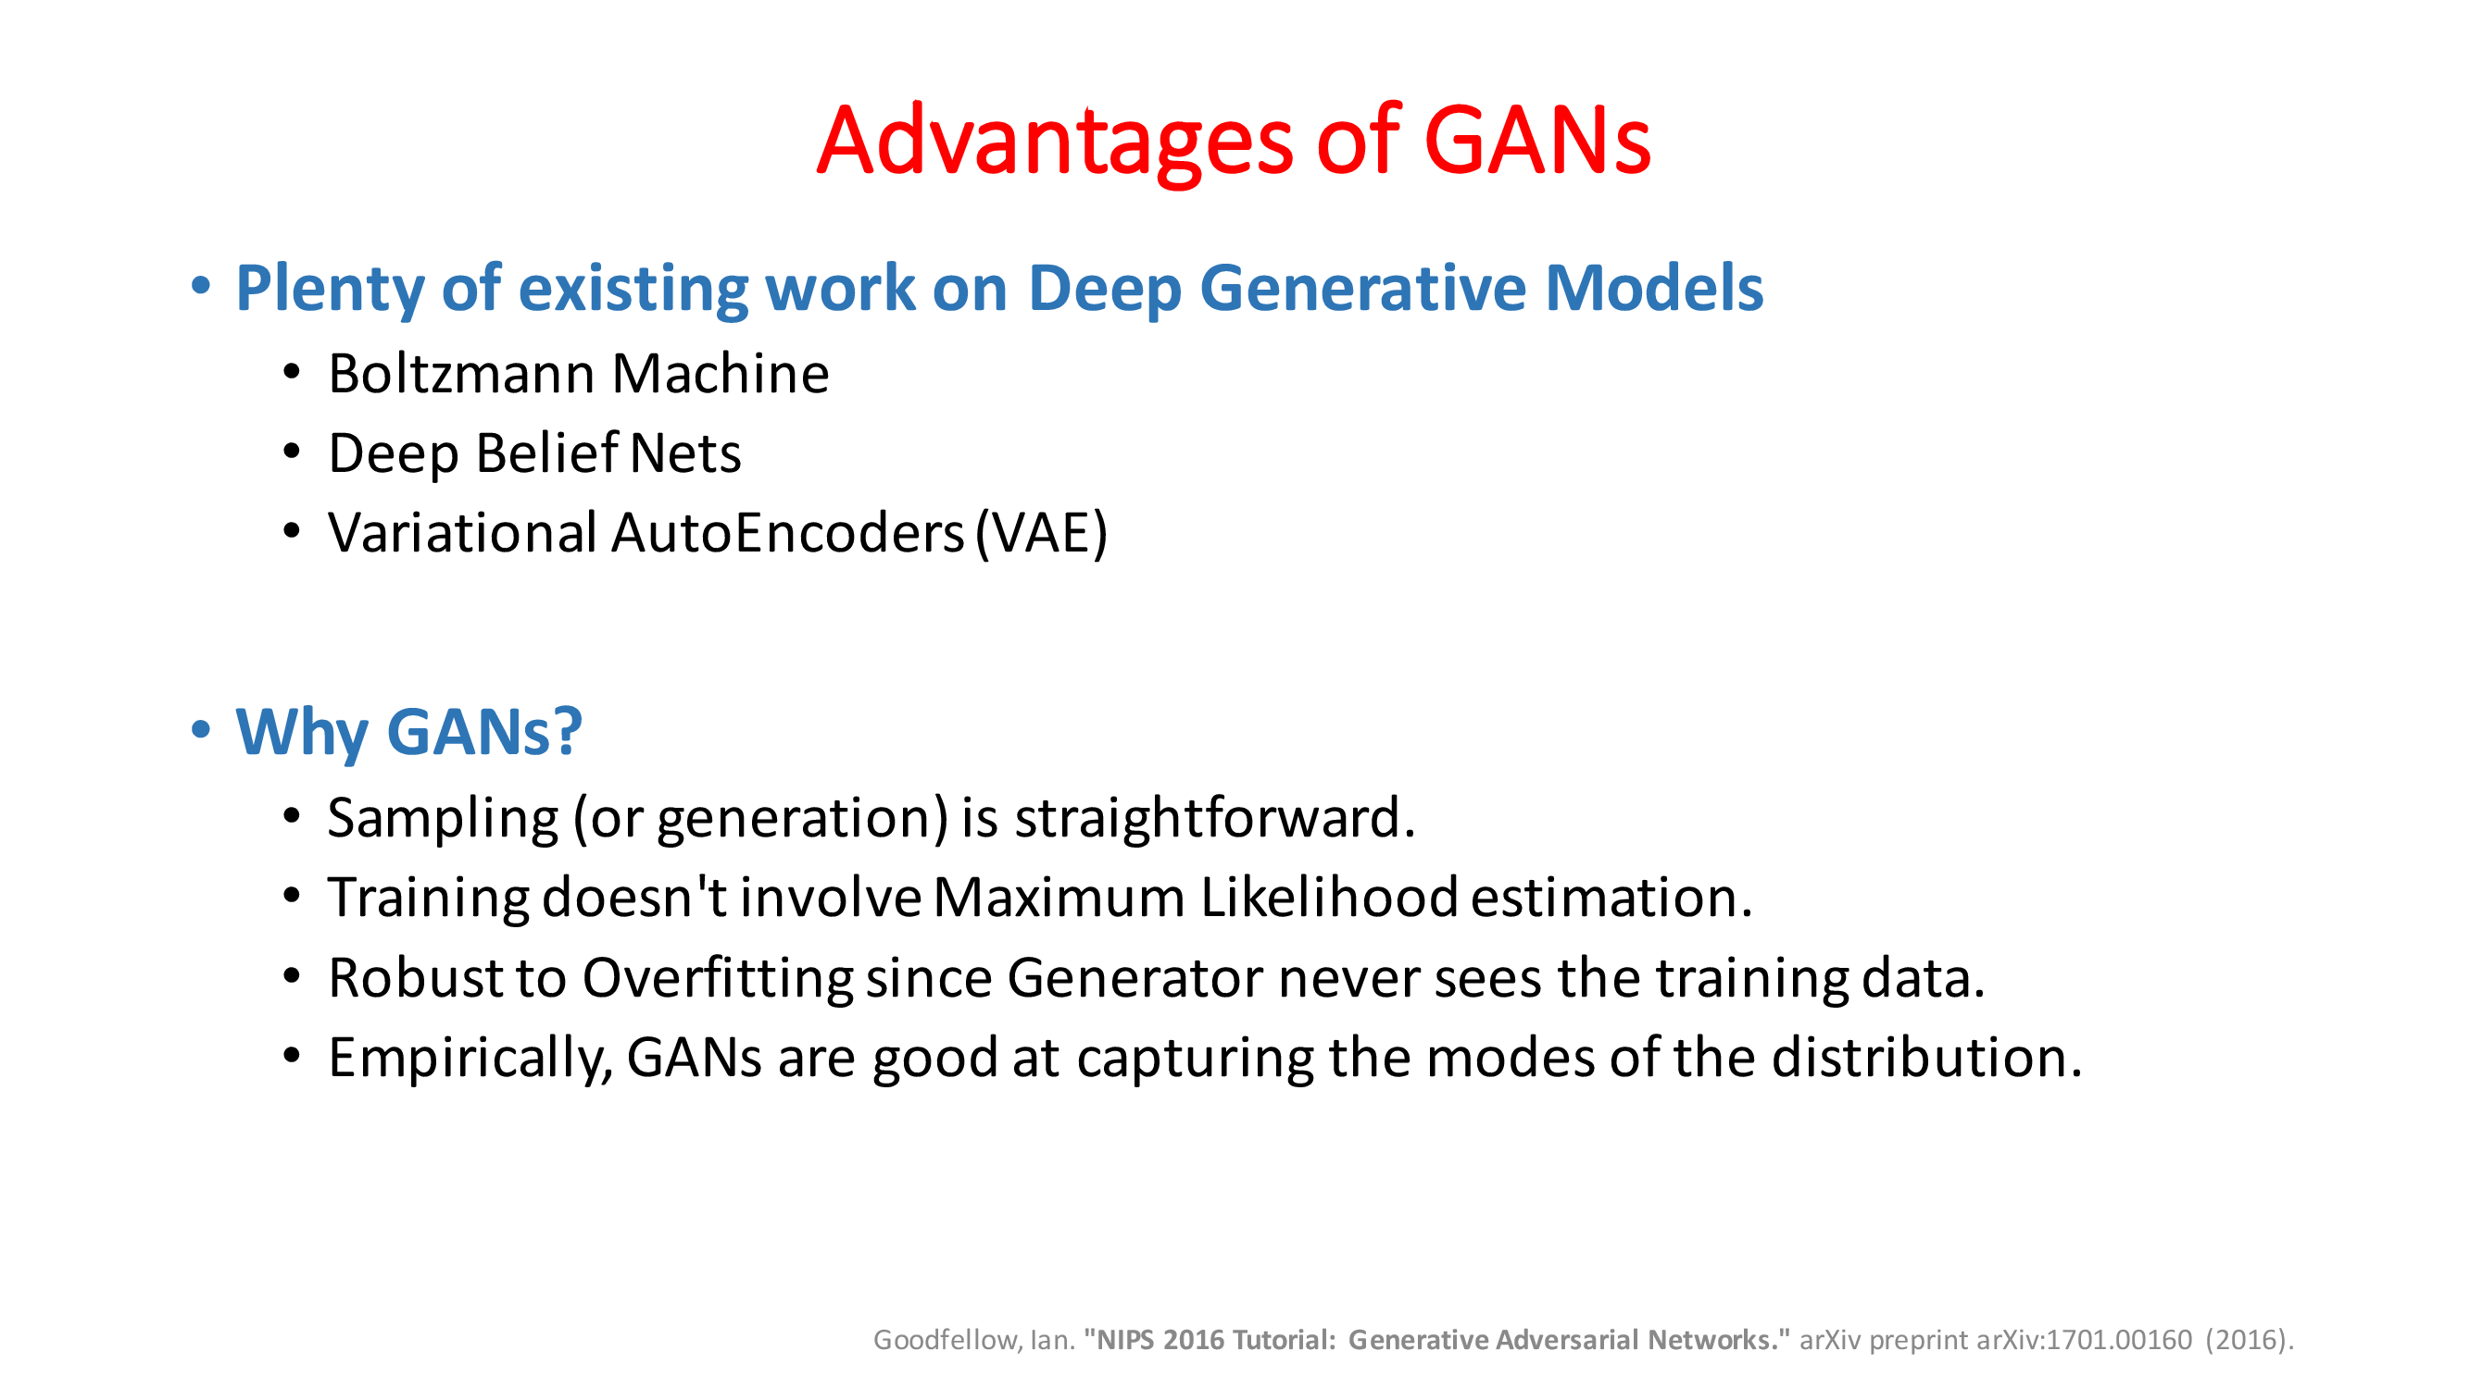

Slide 15
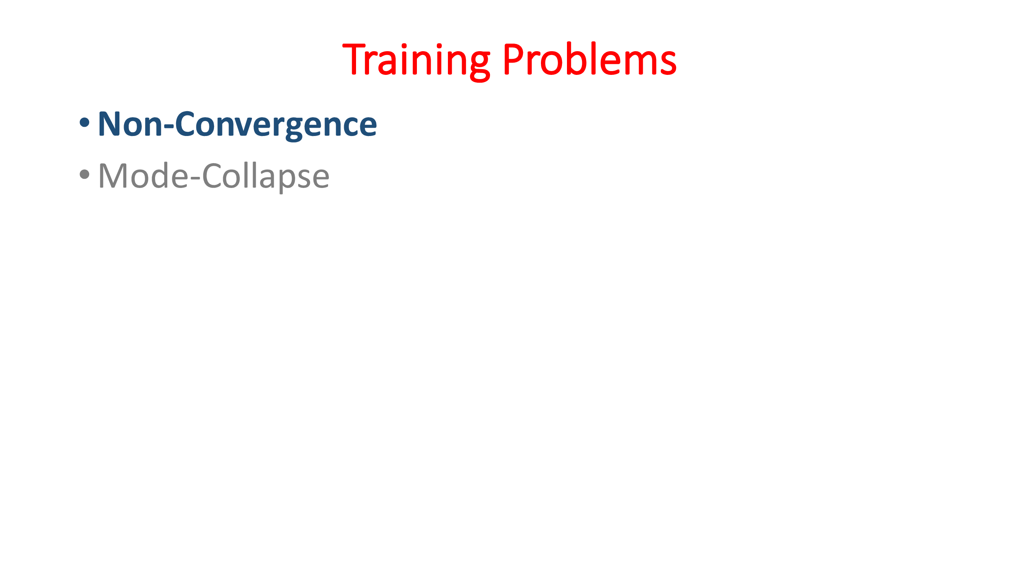

Slide 16
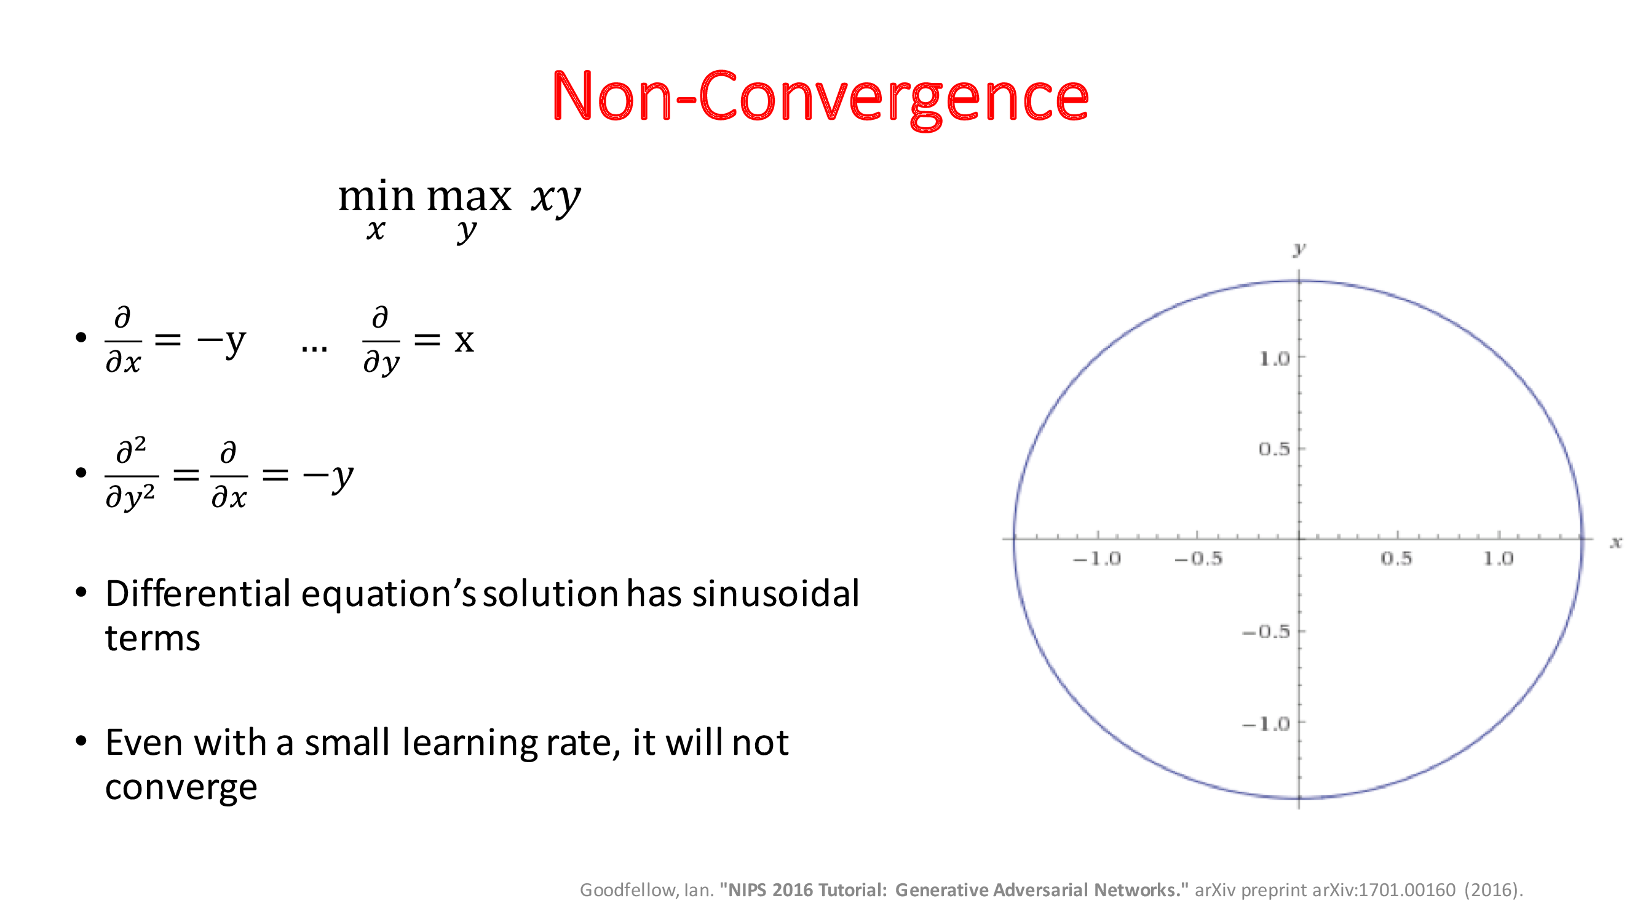

Slide 17
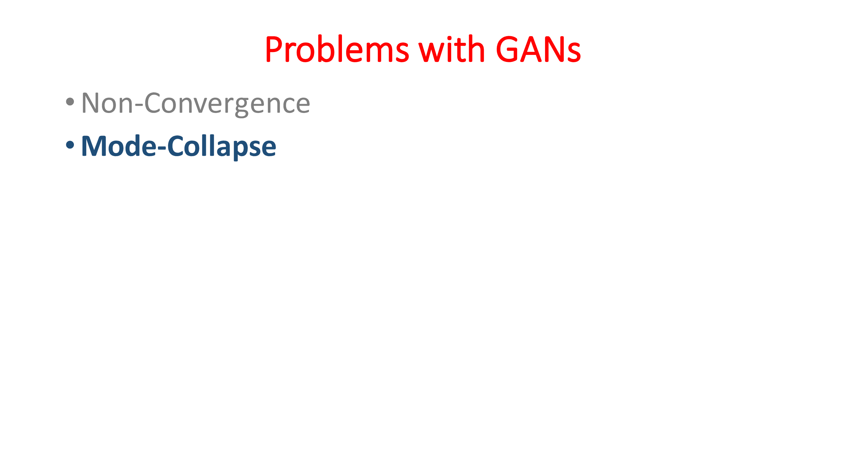

Slide 18
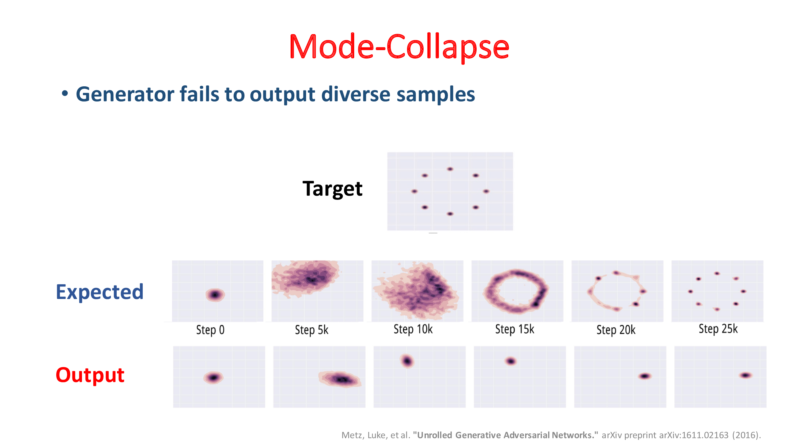

Slide 19
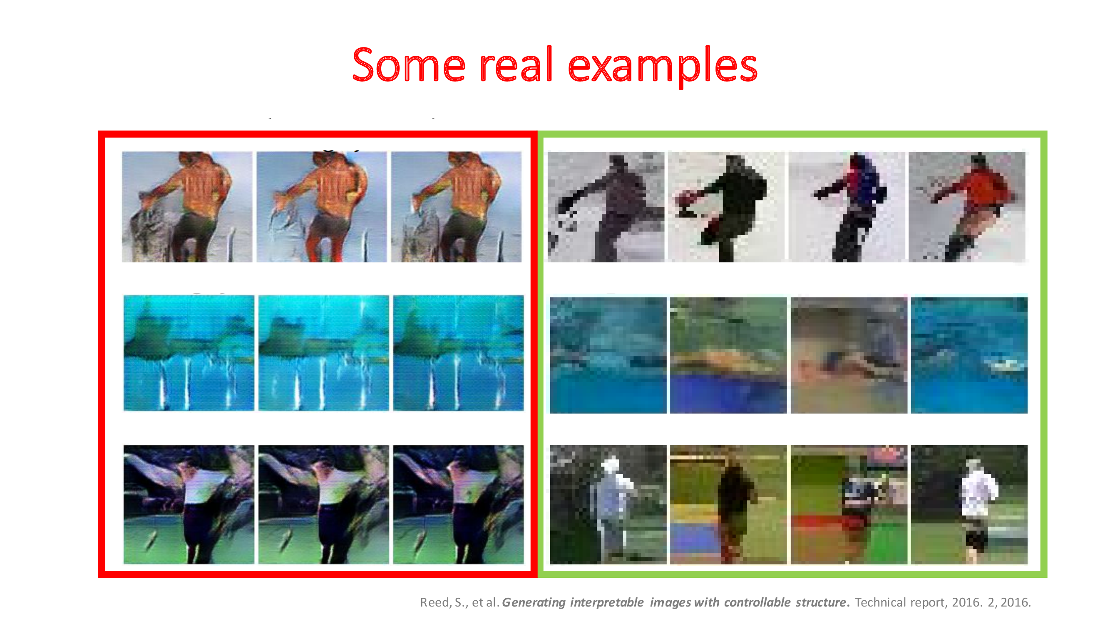

Slide 20
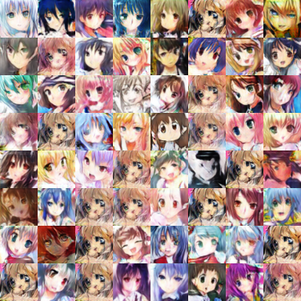
Mode Collapse
Converge to same faces
Generated Distribution
Data Distribution
Sometimes, this is hard to tell since
one sees only what’s generated, but not what’s missed.

Slide 21
Solutions
Use Mini Batch GANs
Supervision with Labels

Slide 22
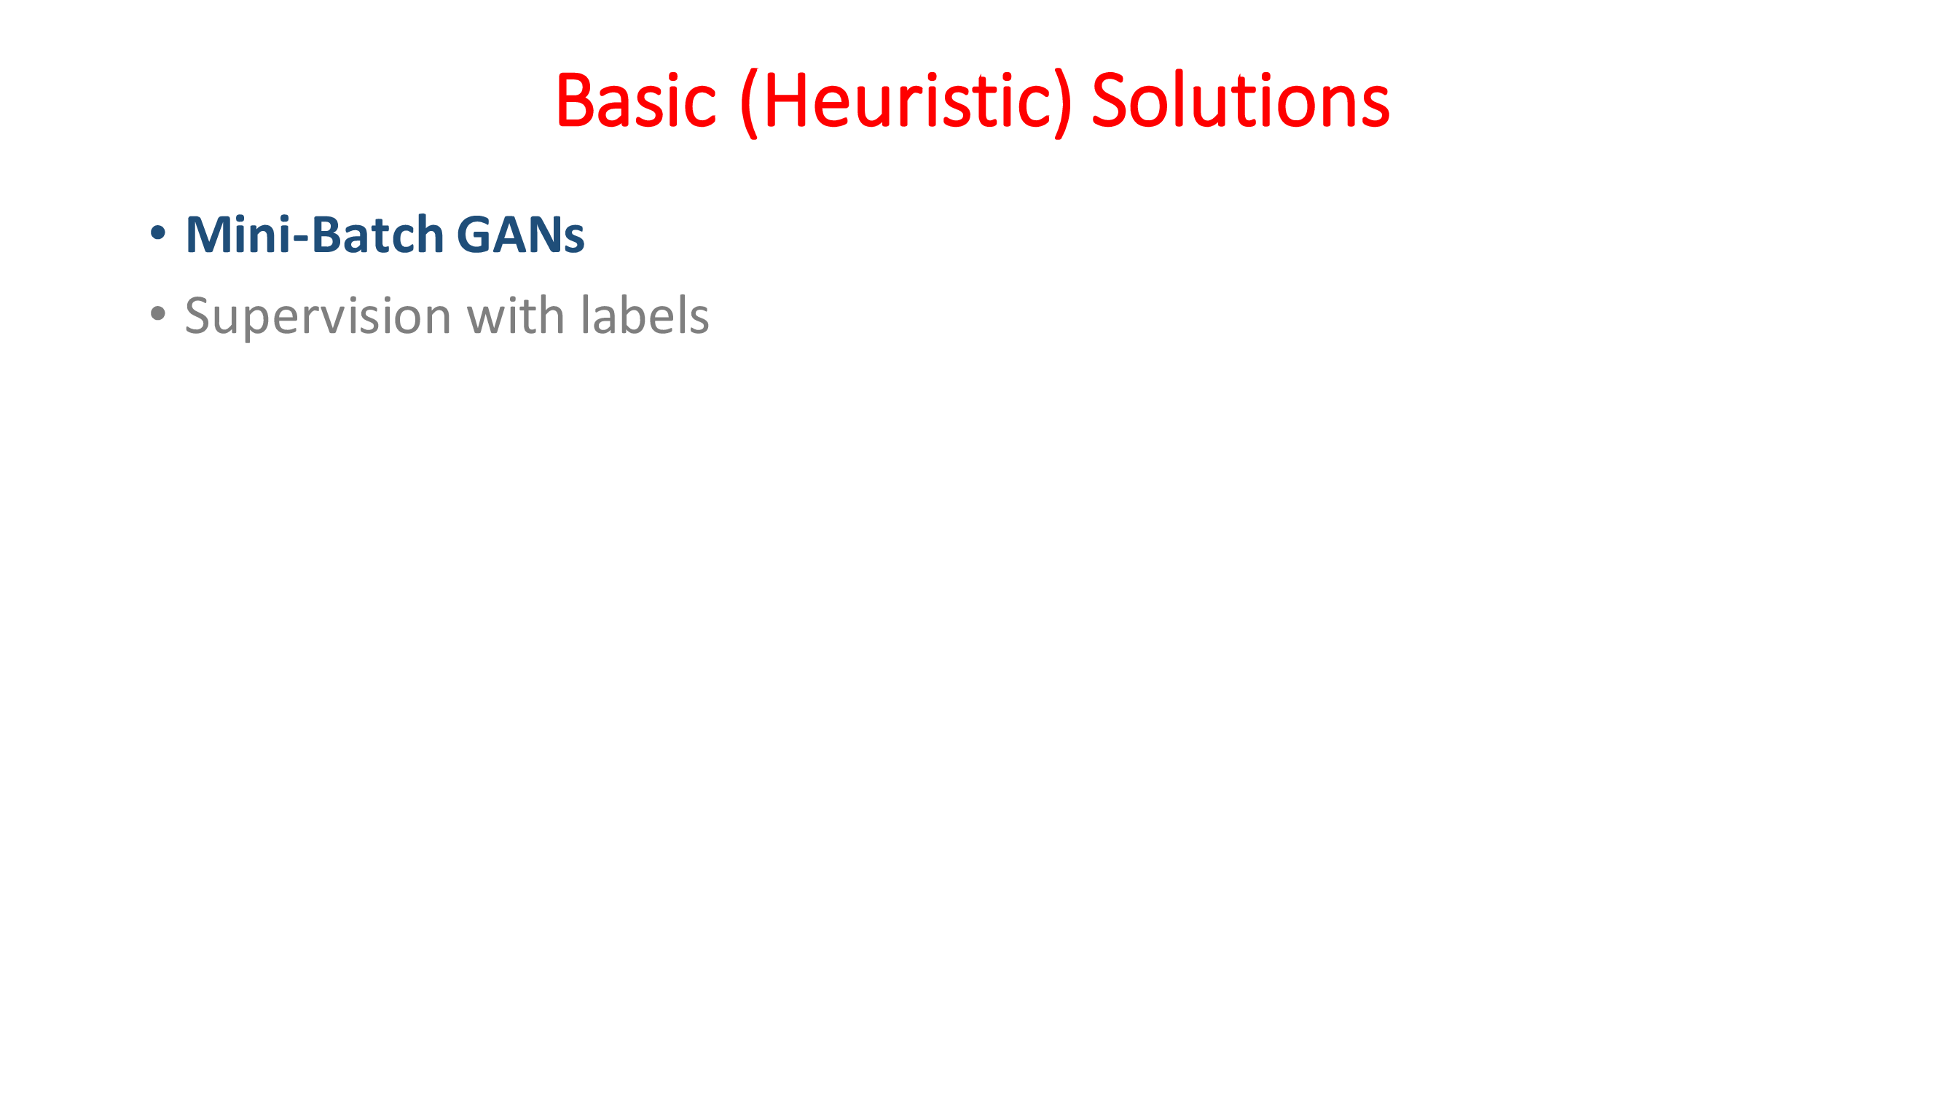

Slide 23
Mini Batch Generative Adversarial Networks (Mini Batch GANs)
Mini Batch GANs are a variation of Generative Adversarial Networks (GANs).
In traditional GANs, the discriminator evaluates each sample individually to decide whether it is real or fake.
In Mini Batch GANs, the discriminator evaluates samples in small groups or "mini-batches".
Concept called mini-batch discrimination
Assess the authenticity of individual samples but also the diversity between samples within a batch.

Slide 24
Mini Batch GANs on MNIST
Deconv
Tanh/Sigmoid
Conv, BN,
LReLU
Conv, BN,
LReLU
Reshape,
FC, BN,
LReLU
FC,
Sigmoid
FC, BN,
Reshape
Deconv
BN, ReLU
100
7x7x16
14x14x8
28x28x1
14x14x8
7x7x16
256
1
Generator
Discriminator

Slide 25
Mini Batch GANs
Generator in Batches
The generator can produce batches of images at once instead of single images.
Processing in batches allows for more efficient computation.
More diversity of samples being evaluated by the discriminator, facilitating a more comprehensive training.
Mini-batch Discrimination
The discriminator uses a measure to assess how much the generated samples deviate from the real samples within the same batch.
Computing distances or similarities between samples in the feature space.
How diverse the generated images are within each batch (mode collapse).

Slide 26
Mini Batch GANs
Backpropagation:
Based on the discriminator’s feedback the GAN updates both the generator and discriminator.
The generator learns to produce more diverse and realistic samples
Iteration:
This process repeats over many cycles
The generator and discriminator iteratively improving in response to each other's feedback.

Slide 27
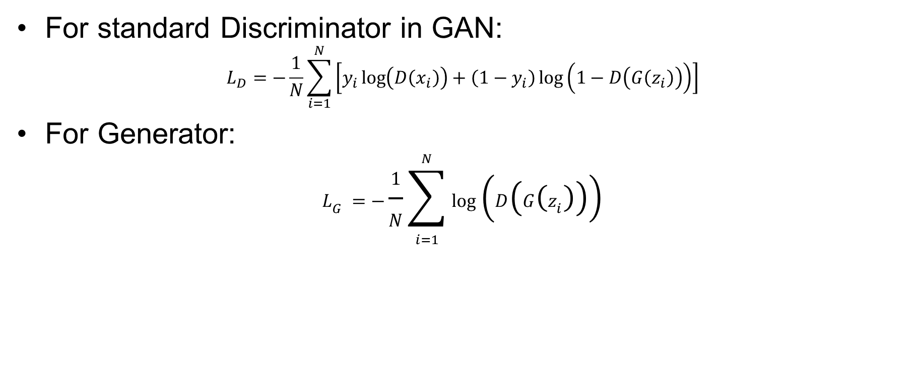
Mini Batch GANs
For standard Discriminator in GAN:
$$L_{D}=−\frac{1}{N}\sum_{i=1}^{N}{\left[y_{i}\log\left(D\left(x_{i}\right)\right)+\left(1−y_{i}\right)\log\left(1−D\left(G\left(z_{i}\right)\right)\right)\right]}$$
For Generator:
$$L_{G}=−\frac{1}{N}\sum_{i=1}^{N}{\log\left(D\left(G\left(z_{i}\right)\right)\right)}$$

Slide 28
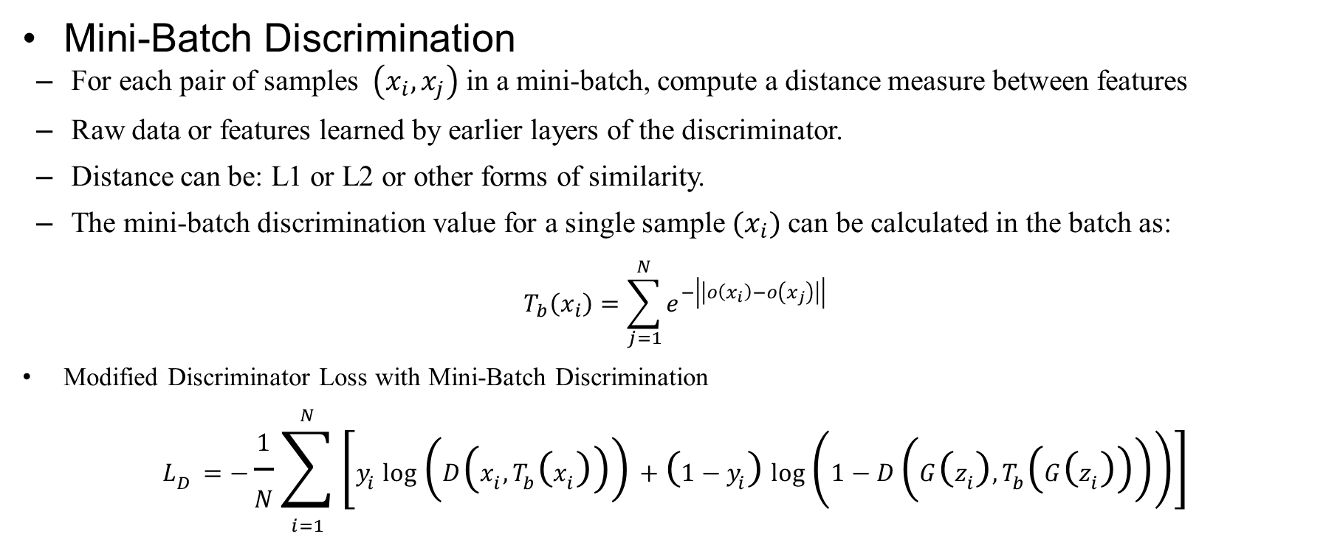
Mini Batch GANs
Mini-Batch Discrimination
For each pair of samples $\left(x_{i},x_{j}\right)$ in a mini-batch, compute a distance measure between features
Raw data or features learned by earlier layers of the discriminator.
Distance can be: L1 or L2 or other forms of similarity.
The mini-batch discrimination value for a single sample $(x_{i})$ can be calculated in the batch as:
$$T_{b}\left(x_{i}\right)=\sum_{j=1}^{N}{e^{−\left|\left|o\left(x_{i}\right)−o\left(x_{j}\right)\right|\right|}}$$
Modified Discriminator Loss with Mini-Batch Discrimination
$$L_{D}=−\frac{1}{N}\sum_{i=1}^{N}{\left[y_{i}\log\left(D\left(x_{i},T_{b}\left(x_{i}\right)\right)\right)+\left(1−y_{i}\right)\log\left(1−D\left(G\left(z_{i}\right),T_{b}\left(G\left(z_{i}\right)\right)\right)\right)\right]}$$

Slide 29
Advantages of Mini Batch GANs
Mini Batch GANs encourage the generator to produce a diverse range of outputs.
Stable training as the discriminator works on a batch instead of individual samples.
Mini batches can lead to faster convergence of the network
Mini-batch discrimination provides more information to the generator, which can help in generating higher-quality samples.

Slide 30
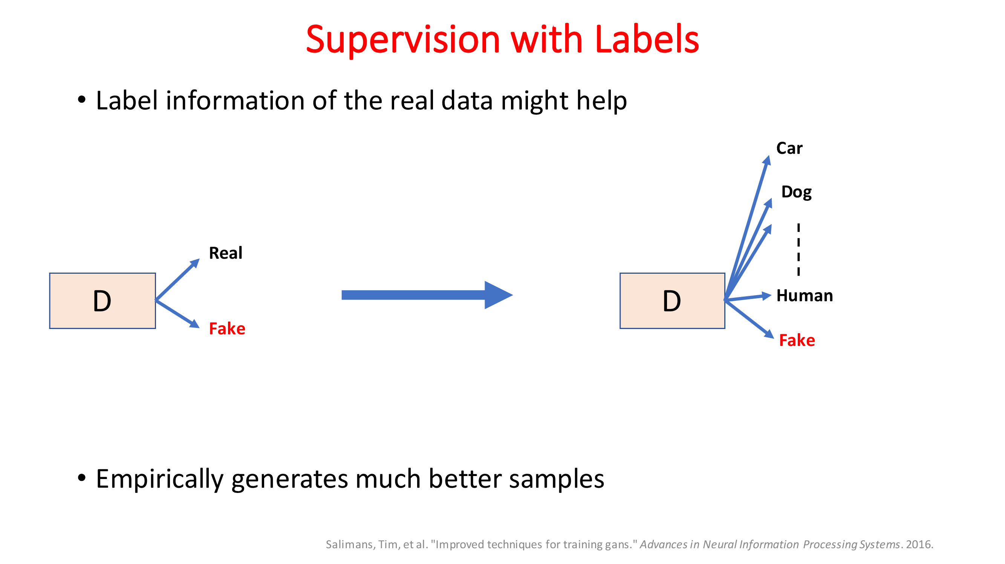

Slide 31
Unsupervised Representation Learning with Deep Convolutional Generative Adversarial Networks

Slide 32
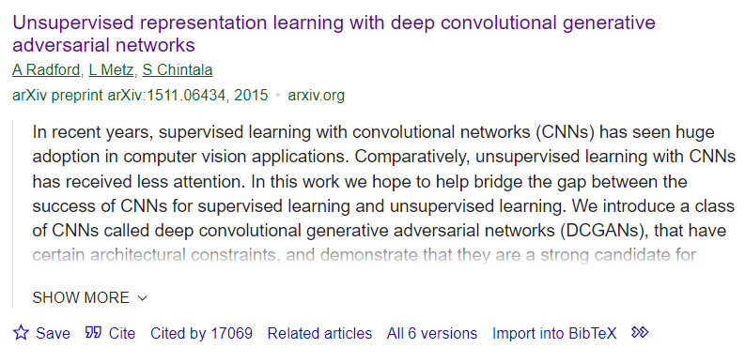
DCGAN

Slide 33
DCGANs
DCGAN: Download Paper.
Supervised learning with convolutional networks (CNNs) has seen huge adoption in computer vision applications
Comparatively, unsupervised learning with CNNs has received less attention
CNN for unsupervised learning
DCGANs builds upon the original Generative Adversarial Networks (GANs) by incorporating convolutional layers, making them more suited for image processing

Slide 34
DCGANS
DCGANs consist of two main components:
Generator: This network generates new data instances (e.g., images) from random noise.
It typically uses transposed convolutional layers to progressively upsample the input noise to an image.
Discriminator: This network evaluates the authenticity of images.
It takes an image (either from the training set or generated by the generator) and outputs the probability of the image being real (as opposed to being generated).

Slide 35
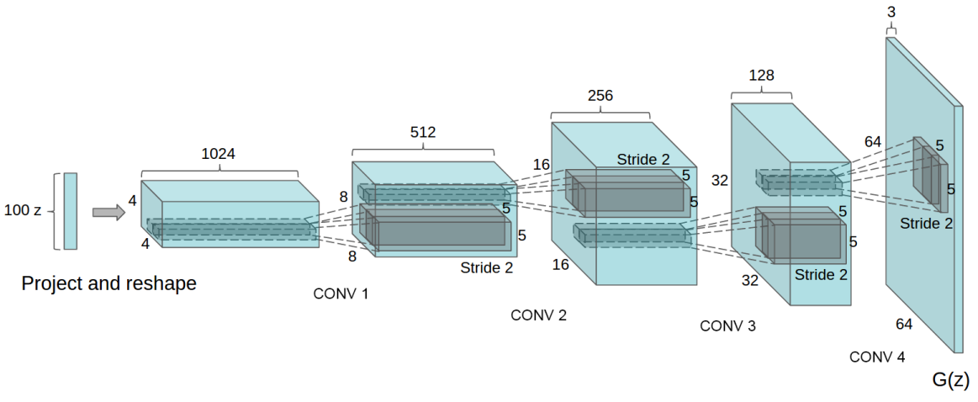
DCGANS

Slide 36
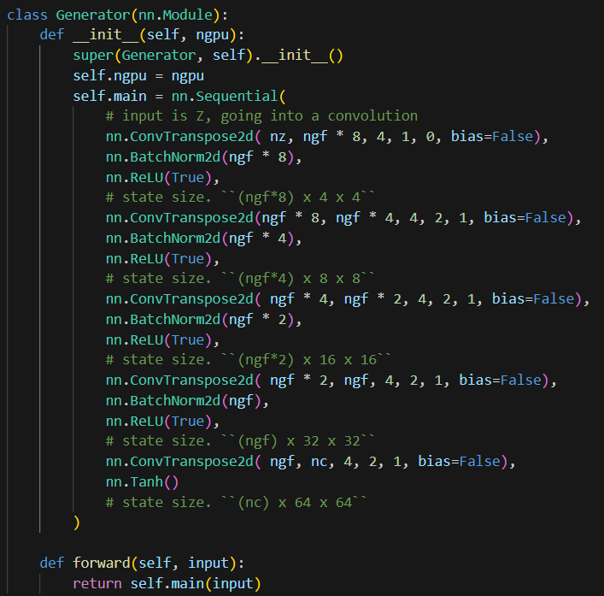

Slide 37
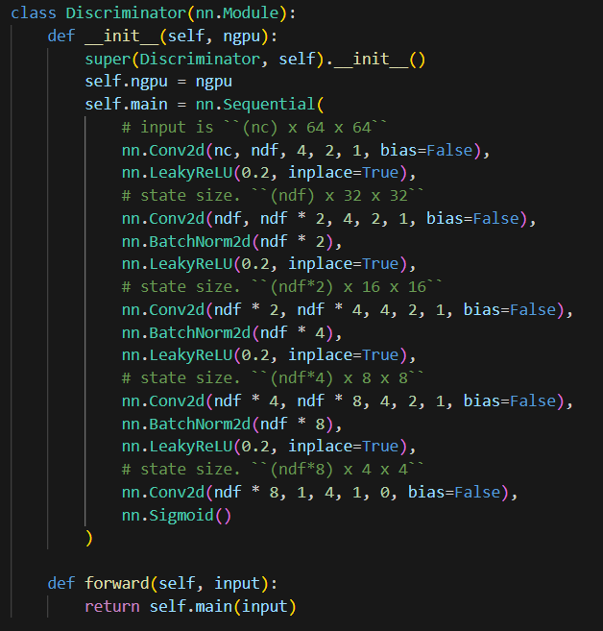

Slide 38
DETAILS OF ADVERSARIAL TRAINING
We trained DCGANs on three datasets:
Large-scale Scene Understanding (LSUN)
Imagenet-1k
Faces dataset.
No pre-processing was applied to training images besides scaling to the range of the tanh activation function [-1, 1].
LeakyReLU with the slope of the leak was set to 0.2.
Adam optimizer with tuned hyperparameters.

Slide 39
DCGANS
Convolutional Layers: DCGANs use convolutional layers (in the discriminator) and transpose convolutional layers (in the generator)
Working Process:
The generator creates images from random noise.
The discriminator assesses these images and real images from the dataset, trying to distinguish between the two.
The output of the discriminator is a probability score that represents how likely it is that the image is real.

Slide 40
Training of DCGANs
Training the Discriminator:
In each training step, the discriminator is trained first.
It is provided a batch of real images (labeled as real) and a batch of fake images generated by the generator (labeled as fake).
The goal is to maximize the probability of correctly classifying both real and fake images.
Training the Generator:
After updating the discriminator, the generator is trained.
It generates a batch of images, which are then passed to the discriminator.
The generator's goal is to minimize the likelihood that the discriminator correctly identifies the images as fake (Adversarial).

Slide 41
Training of DCGANs
Adversarial Process:
As training progresses, the generator improves in generating realistic images, the discriminator must also improve at distinguishing fake images from real ones, and vice versa.
This competition drives both networks to improve (adversarial).
Backpropagation and Optimization:
Both networks use backpropagation to update their weights.
This iterative process of alternating between training the discriminator and the generator continues until a stopping criterion is met (like a fixed number of epochs or a desired level of performance).
Loss Functions:
Commonly used loss functions include binary cross-entropy
The generator’s loss is based on how well it tricks the discriminator.

Slide 42
Key Features
Stability:
DCGANs often offer more stable training compared to traditional GANs, partly due to their convolutional nature.
Hyperparameters:
Tuning hyperparameters (like learning rates, batch size, etc.) is crucial for effective training.
Mode Collapse:
A common issue with GANs, including DCGANs, is mode collapse, where the generator produces limited varieties of outputs.

Slide 43
Key challenges
Some strategies to mitigate Mode collapse:
Adding Noise to Inputs:
Introducing noise to the inputs of the discriminator can prevent the discriminator from becoming too confident.
This uncertainty can prevent the generator from exploiting weaknesses in the discriminator, leading to a more stable and diverse output.
Regularization Techniques:
Applying regularization methods like gradient penalty or weight normalization can help in stabilizing the training and thus prevent mode collapse.
Using Different Architectures or Loss Functions:
Sometimes, simply changing the architecture of the GAN or using a different loss function can mitigate mode collapse.
Conditional GANs

Slide 44
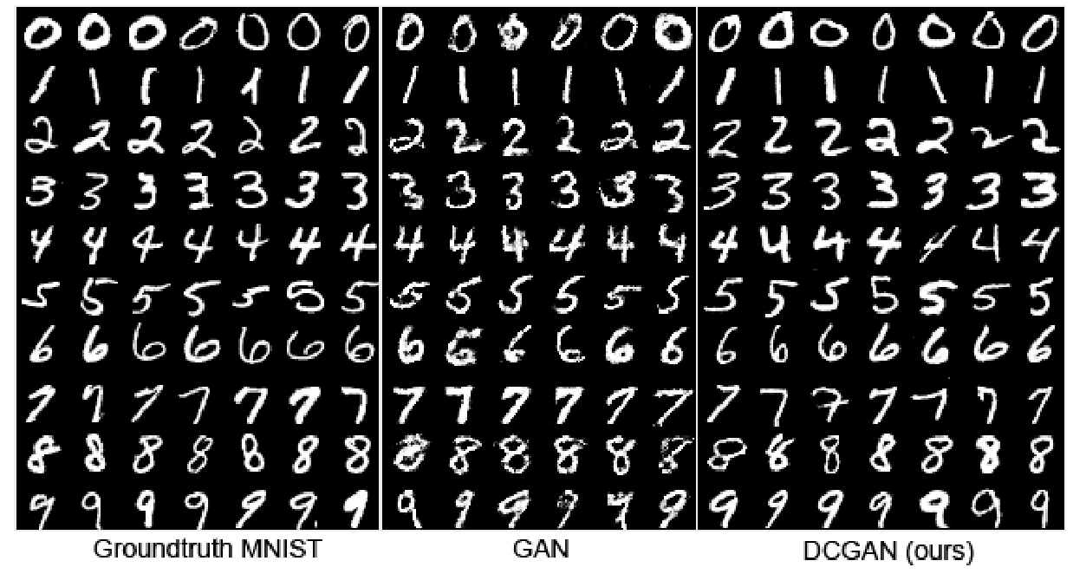
DCGANs Results

Slide 45
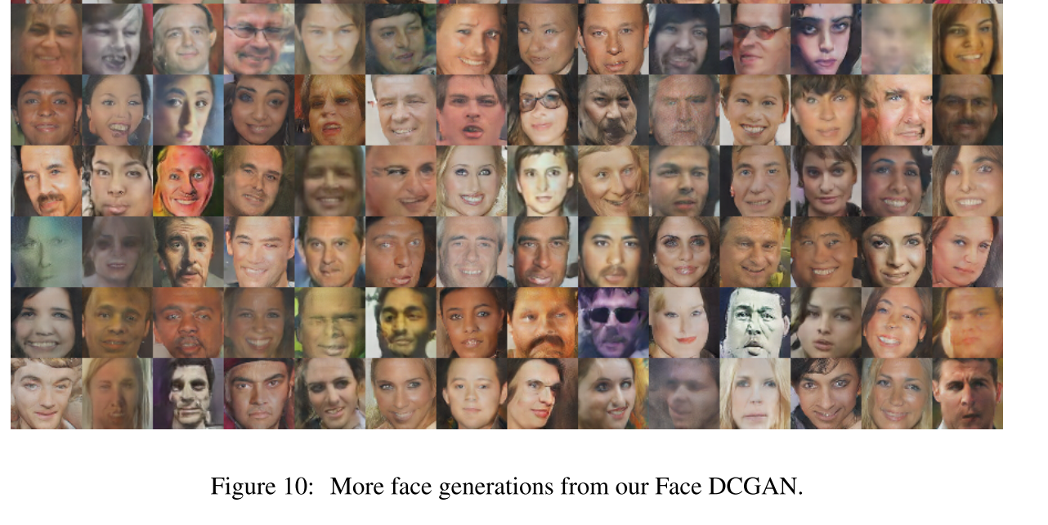
DCGANs Results

Slide 46
Guidelines for DCGANs
Architecture guidelines for stable Deep Convolutional GANs
Replace any pooling layers with strided convolutions (discriminator) and fractional-strided convolutions (Transposed Convolutions) (generator).
Use Batchnorm in both the generator and the discriminator.
Remove fully connected hidden layers for deeper architectures.
Use ReLU activation in generator for all layers except for the output, which uses Tanh.
Use LeakyReLU activation in the discriminator for all layers.

Slide 47
Research Tasks
What is momentum? Explain the use of the Momentum term in Neural Networks.

Slide 48
References
Pix2Pix
Tensoflow Implementation: https://www.tensorflow.org/tutorials/generative/pix2pix
Original Paper: https://arxiv.org/abs/1611.07004

Slide 49
Thank You ☺

